Slide 1
Connecting to our Communities
Tuesday 25 April

Slide 2
Agenda Welcome Peter Roderick (5 Minute) Introduction to Population Health Hub (PHH) Peter Roderick (5 mins) 3. Ways to wellbeing: Christine Marmion (York CVS) (15mins) 4. Using RAIDR tool to support Proactive Social Prescribing: Peter Roderick (15 mins) 5. PHH case tutorial: Fingertips 'wider determinants' tool: Heather Baker (15 mins) 6. Questions (5 mins) PLEASE CAN YOU REMAIN ON MUTE UNTIL THE QUESTIONS SECTION – THANK YOU
Aims of the session:
to help people to understand more about the power of data to target services to improve health outcomes
to learn how CVS is connecting people to local community support to make them feel better
Key resources:
Fingertips: a large public health data collection organised into themed profiles.
RAIDR tool: leading health intelligence tool that underpins approach to PHM

Slide 3
Introducing the Population Health Hub

Slide 4
Enabling
Lunch and Learns
Developing infrastructure (e.g. IG)
Metadata project
PCN capacity building
Data tool e.g. RAIDR
Good practice from elsewhere (link into ICB)
LD identification
Analysing
JSNA core process
Health Needs Assessments
Census 2021 data
PCN / Ward profiles
Inequality Visualisation
A+E attendance small-area analysis
Understanding and reducing the Health impacts of the Cost-of-Living Crisis in York
ICB CYP asthma pack
Doing
Early Intervention in Diabetes project
Waiting Well project
Improving Dementia Diagnosis rates (Brain health café)
Proactive Social Prescribing
PHM approach to bereavement in York

Slide 5
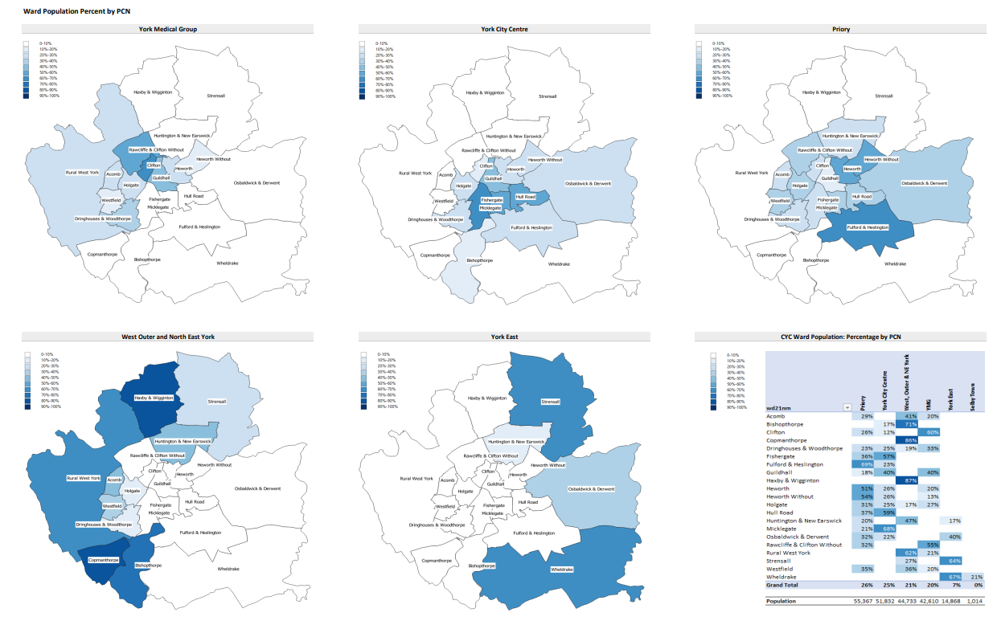
Exploring health inequalities in York
Understanding the picture of need through CORE20PLUS5 in York
Exploring the health impacts of the cost of living crisis for York’s residents
Breakdown of the resident population of each of the five York PCNs, by ward to aid with service planning
Analysis of LSOA A&E attendance by age and sex, including information on the characteristics of the population by location and levels of deprivation

Slide 6
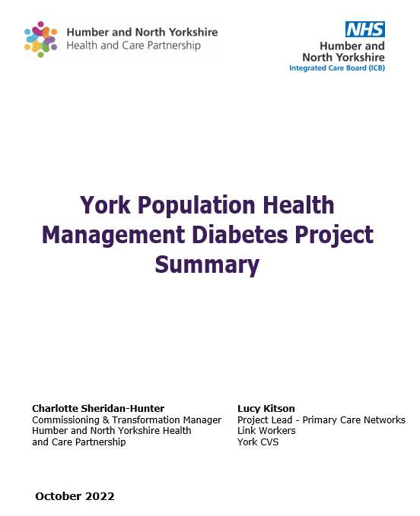
Diabetes PHM Project
PHM Proactive Social Prescribing project:
to support people to live well with type 2 diabetes through an asset- based approach
multi-agency approach to analyse data to identify cohort of 400 patients in York living with type 2 diabetes with risk factors for their disease progressing to further complications or other long-term conditions.
Individuals were also in the bottom 50% IMD score and demonstrated minimal engagement with Primary Care in 2019/2020.
Partnership Approach, working closely with CVS Social Prescribing team to:
build a 'logic model' of change to support people to live well with diabetes and avoid progression into living with multiple long-term conditions.
proactively reach out to the cohort, helping to build a personalised asset-based plan for their care, signposting to resources to manage their diabetes, and helping people to get the support they need to live healthy lives.
Outcomes
Increased referrals to weight management programme and local/community groups and charities with follow up from social prescriber for patients
Improved ONS, CSE and anxiety scores
Strengthened partnership working - CYC Health Trainers and Healthwise
Future learning to inform service delivery
Improving access to diabetes reviews – accessibility communication and education
Recording referral outcome to understand benefit of interventions
Linking levels of clinical and social input to risk stratification
Retinol screening – improved recording in primary care

Slide 7
Social Prescribing and Population Health: An Introduction
Christine Marmion
Christine.marmion@yorkcvs.org.uk
25th April 2023

Slide 8
Social prescribing – the principles
Supports individuals to take greater control of their own health
Person Centred
Holistic
Non-medical support
What Matters to Me and asset-based approach
Person involved in making decisions to improve their health and wellbeing
A community-centred approach to health
recognises the importance of the communities we live and work in, and the social networks we belong to
promotes health and wellbeing
reduces health inequalities in a community setting
connects people to local community assets AND strengthens local community assets
Health inequalities
evidence that people’s health and wellbeing are determined mostly by a range of social, economic and environmental factors
A new approach to population health
Reduce pressure on statutory services
by directing people to more appropriate services and groups
Helping people have more control
Helping people to live well longer reducing A and E admissions and hospital stays.
Notes:
Lucy

Slide 9
Proactive Social Prescribing and Population Health
VCSE partners and local clinical leaders were required to design, agree and put in place a targeted programme to proactively offer and improve access to social prescribing to an identified cohort with unmet needs.
Tackling neighbourhood health inequalities - identify a population experiencing inequality in health provision

Slide 10
An Example:
A proactive social prescribing project focussed on a cohort of people with respiratory conditions who are likely to be affected by the cost-of-living crisis
Target Population:
People likely to be affected by the rising cost of living
People at risk of non-elective admission
People with respiratory conditions
· Patients will be identified using an agreed, consistent clinical search across each practice​
. We are also exploring how we can use RAIDR to identify those that are high risk of admissions of COPD and the individuals PCN to avoid hospital admissions
· We will agree the inclusion and exclusion criteria for this search, based on condition, deprivation, risk of admission and contact with other services

Slide 11
Intervention:
Holistic Approach
ALWAYS Person Centred and Asset Based
What Matters to Me
Health Literacy
Solution Focussed
Building Relationships
Connecting and collaborating with the VCSE and Statutory Services
A multi-agency approach
Attending groups with patients
Open door policy on discharge from the service
Adressing the Social Determinates of Health
Personalised Care planning
Notes:
Lucy

Slide 12
Outcomes:
Opportunity to address barriers to accessing healthcare and share learning
Increased numbers of people accessing health appointments and reviews preventing an escalation in conditions
Ongoing support to address social determinates of health
Improved health literacy
Access to ongoing support within the community which can run alongside clinical interventions
More appropriate use of primary care and admissions avoidance
Bert's story: Bert became known to us through an LD review but this was just the beginning of the story

Slide 13
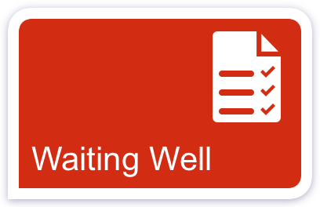

Slide 14
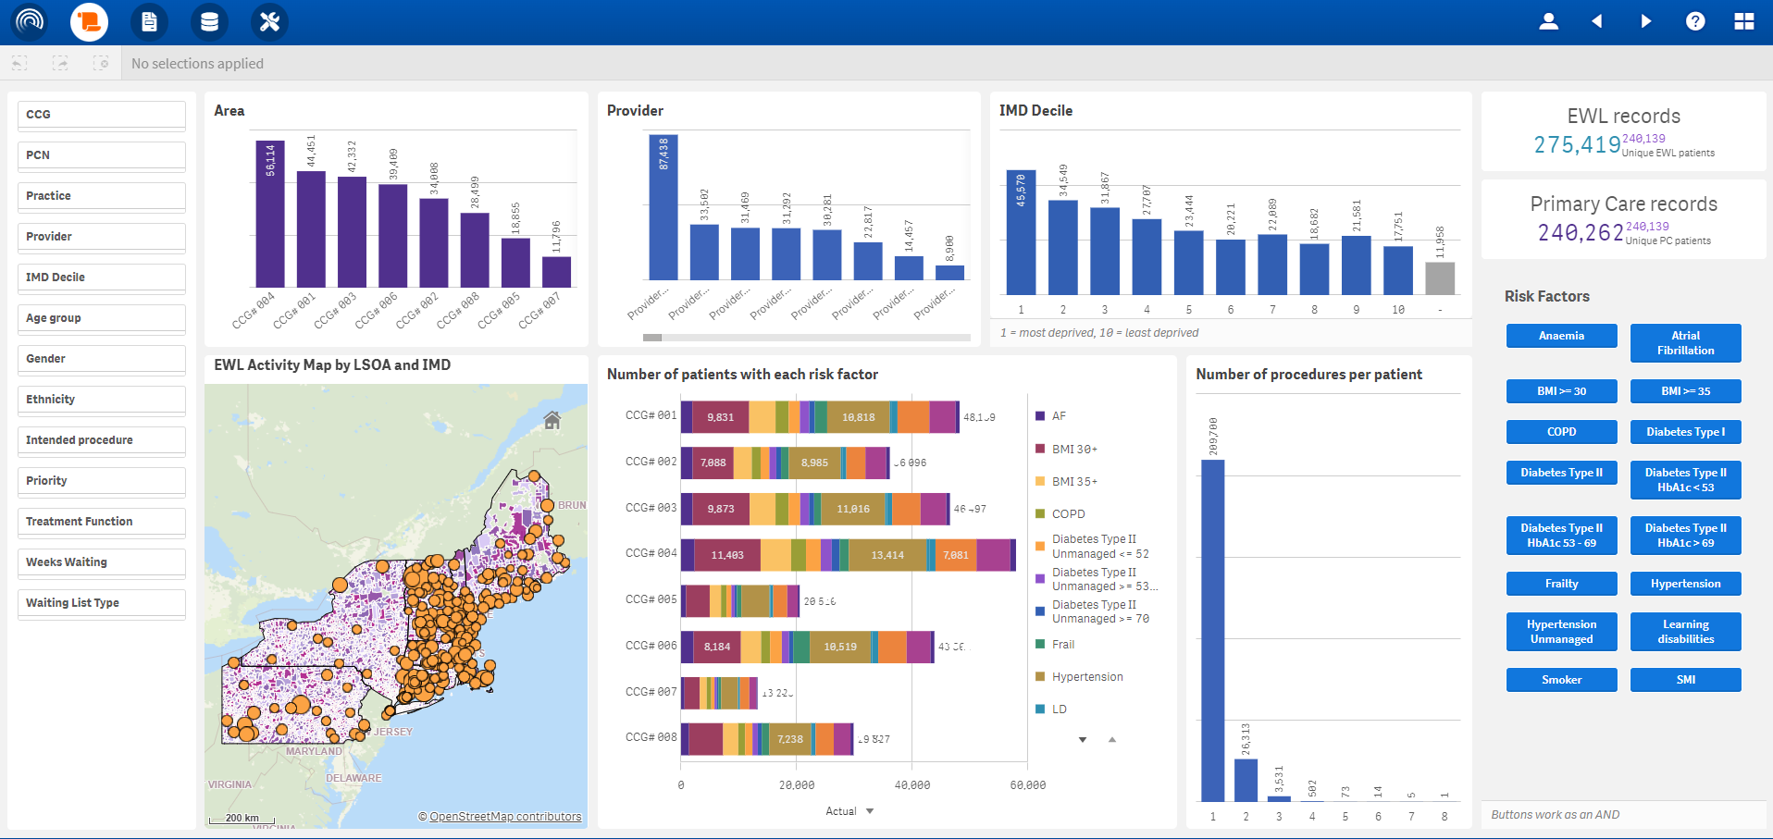
Waiting Well – Patient Summary
RAIDR’s unique to the market Waiting Well solution was developed to assist ICBs, Providers, PCNs and GP Practices to quickly identify cohorts of patients that are currently awaiting an elective procedure.
Combining linked primary care and national elective waiting list data, the dashboard can enable users to target individual patients who may need support managing their long-term conditions to remain eligible for their intended procedure. In essence, to ensure patients are ‘waiting well’.

Slide 15
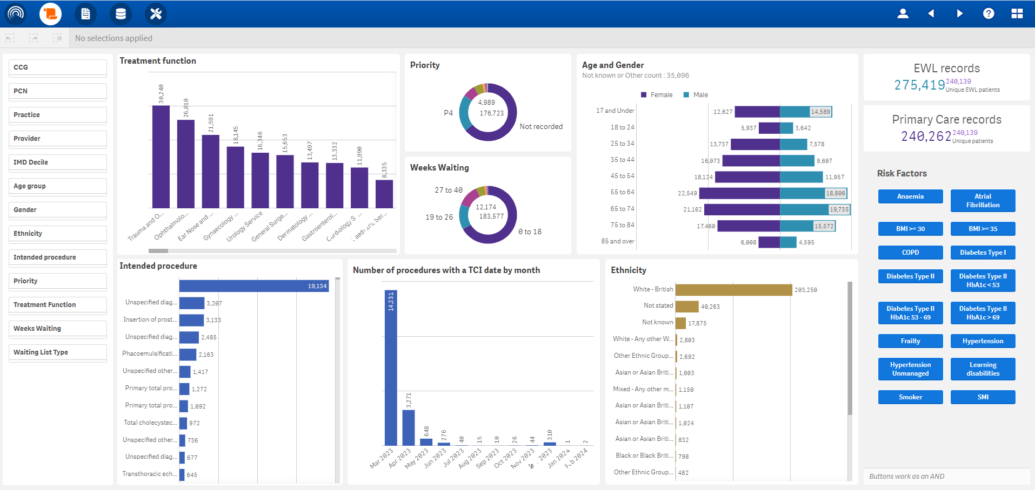
Waiting Well – Waiting List Summary
Tackling the elective waiting list backlog is one of the key priorities for health and social care.
Utilising the Primary Care data extracted from your GP clinical systems, the dashboard risk stratifies your selected cohort of patients awaiting an elective procedure.
Using a variety of filters, the dashboard provides the user with the ability to drill down based on health inequalities, treatment function group and demographics.

Slide 16
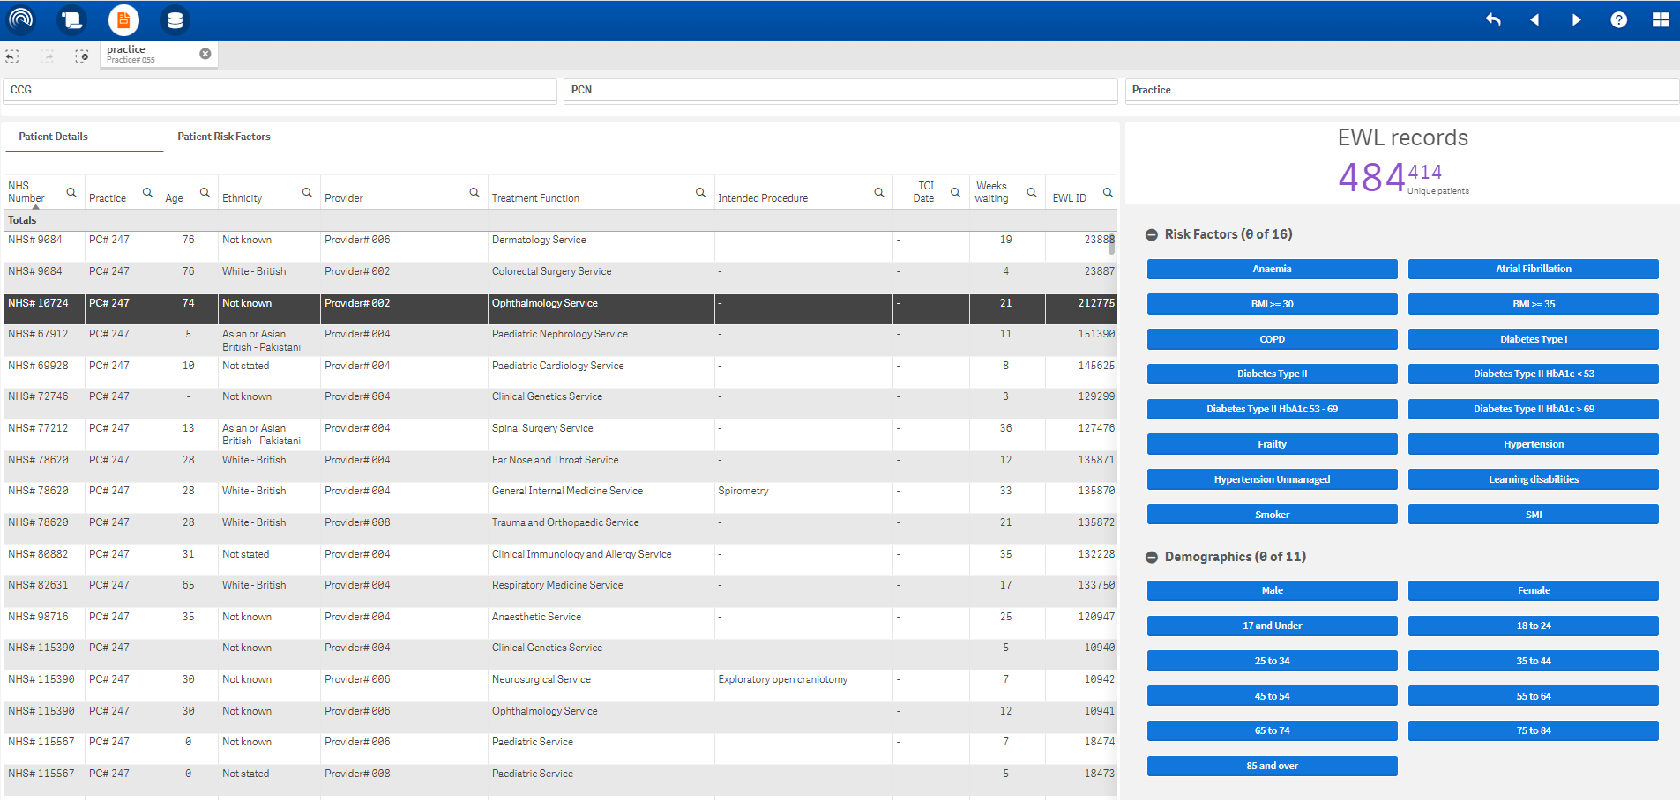
Waiting Well – Patient Details
Users with the correct access can deep dive into the data further using the expandable buttons to investigate risk factors, demographics and whether they reside in areas of deprivation based on the Index of Multiple Deprivation (IMD).
Clear NHS numbers available for those RAIDR users with Patient Identifiable Data (PID) access.

Slide 17
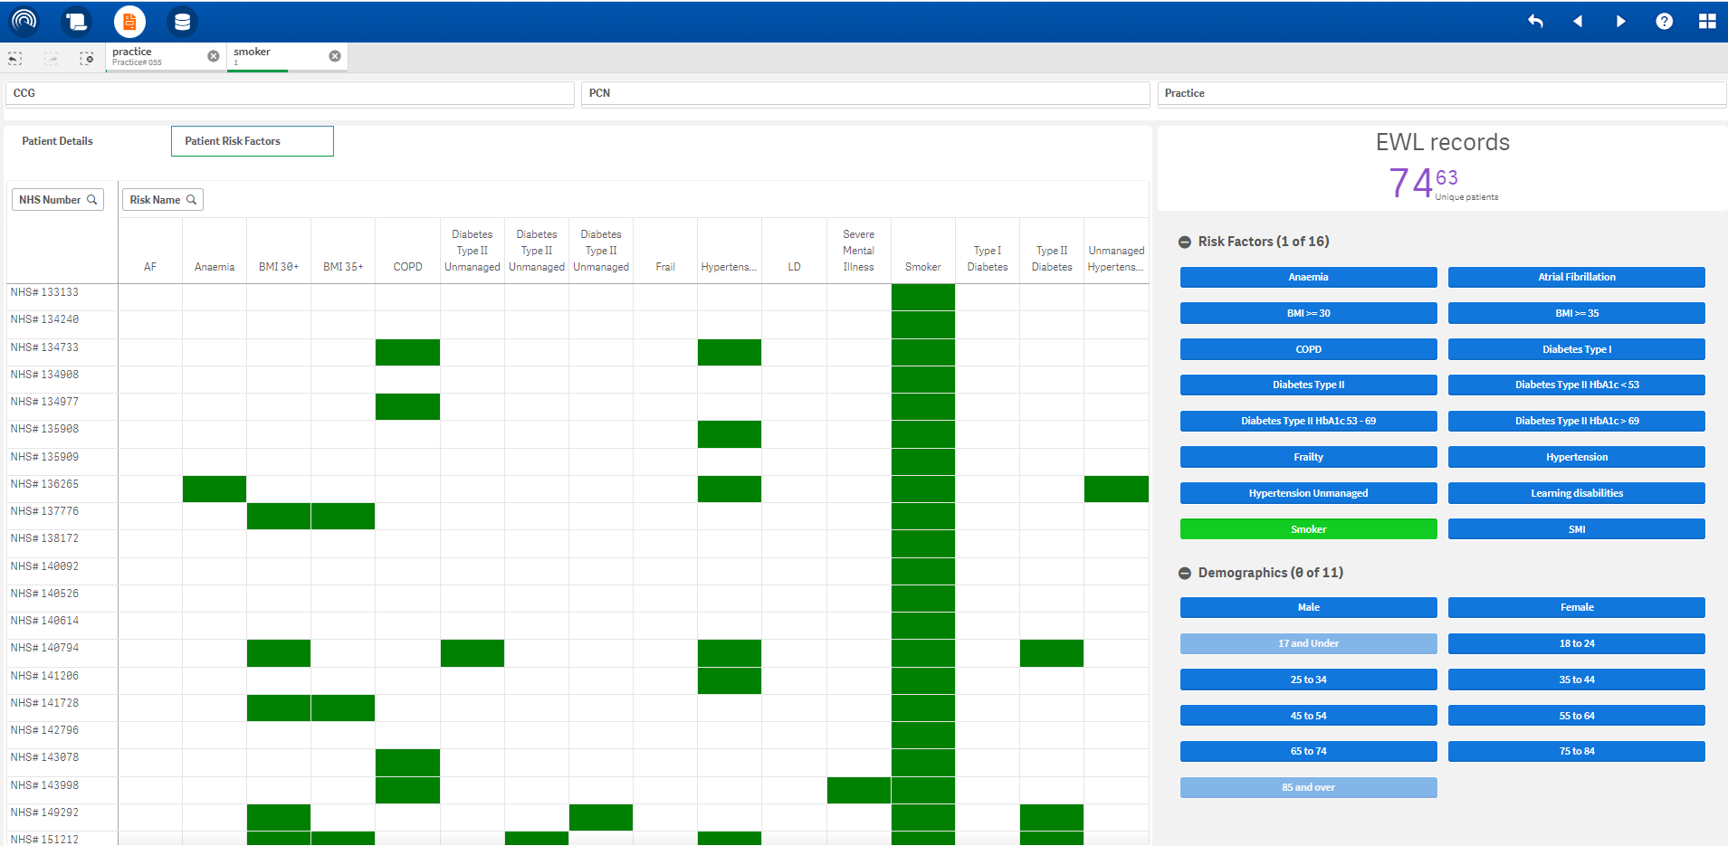
Waiting Well – Patient Risk Factors
Users are able to move between the Patient Details and Patient Risk Factors using the toggle at the top of the chart enabling quick and effective risk stratification

Slide 18
Waiting Well – Case Study from the NE
Healthworks are an award winning charity in the North East and North Cumbria region who support patients to reduce the risk of preventable ill health while promoting equality, diversity and inclusion. The charity recently utilised RAIDR’s Waiting Well dashboard to identify patients on the elective waiting list who required targeted intervention to improve their physical and mental wellbeing as well as ensuring they remained eligible for their intended treatment.
John’s Story
John was referred to the Pre-op DREAMS Programme after being identified by Waiting Well as a patient with potential risk factors. Diagnosed with prostate cancer and with his diabetes unmanaged, John required support to improve his lifestyle. As a result, John’s HbA1c reduced from 54 to 42 over a period of 12 weeks. His diet has significantly improved and his alcohol intake reduced.
Gary’s Story
Gary was awaiting a knee operation however his unmanaged diabetes had led to regular hypos and he had sought advice on how to control his blood sugar levels. The Lifestyle team contacted Gary after he was highlighted as a potential risk utilising the dashboard. At the end of the 12 week programme, Gary reported having fewer hypos and had reduced his HbA1c from 64 to 45 as well as losing 7.5kg of body weight. The Lifestyle team also referred Gary to the PCN Pharmacist for insulin help and support. Gary has noticed an improvement in his overall fitness, reducing the need for his inhaler.

Slide 19
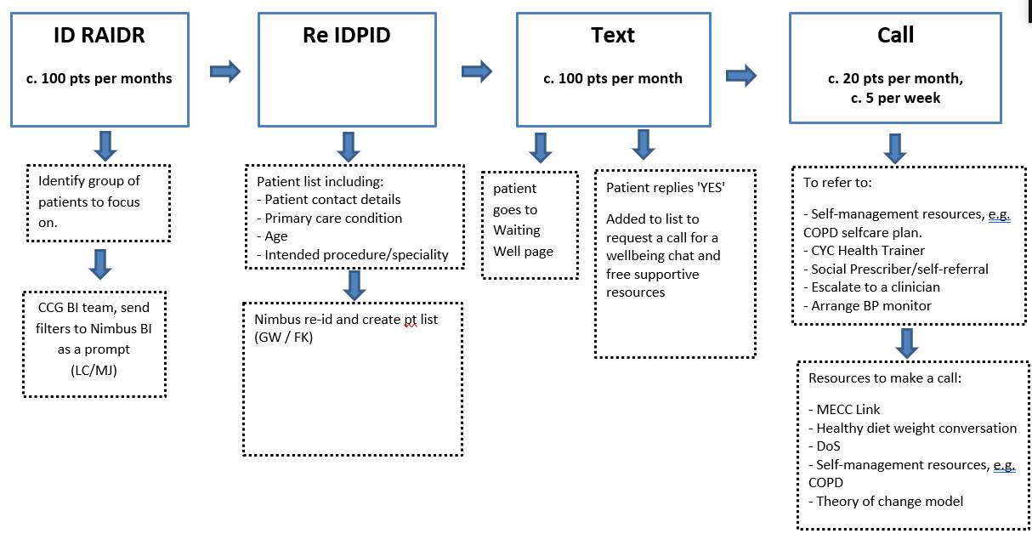
Waiting Well – piloting locally

Slide 20
PHH Case Tutorial: Fingertips ‘Wider Determinants’ Tool
Heather Baker, April 2023
Notes:
Aims of this talk: to give a brief overview of Fingertips and how to obtain the relevant data; use a case study as an example

Slide 21
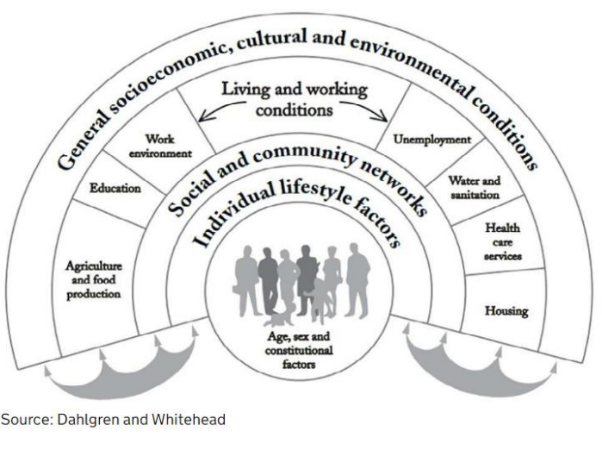
Outline
The wider determinants of health are a diverse range of social, economic and environmental factors which influence people’s mental and physical health.
The link between social inequalities and health outcomes is significant- they have a major impact on health.
By addressing the wider determinants of health, health equity will improve.
Notes:
Dahlgren and Whitehead rainbow (1991)- places individuals at the centre with various layers of influences on health surrounding them, inc. individual lifestyle factors, living and working conditions, other general social conditions.

Slide 22
OHID Tool (Fingertips)
Wider Determinants of Health
The built and natural environment
Education
Employment
Income
Crime
Communities and social capital
Local Health- Small Area Public Health Data
Population and demographic factors
Wider determinants of health
Health outcomes
Notes:
Health Profile: Detailed Analysis and charts

Slide 23
Wider Determinants of Health
Notes:
Landing page. Can either select each tile or click on start. The tiles will provide links to other data sources for more in depth research

Slide 24
Wider Determinants of Health
Notes:
Landing page. Can either select each tile or click on start. The tiles will provide links to other data sources for more in depth research and broader views

Slide 25
Wider Determinants of Health
Notes:
Return to landing page to select Start button

Slide 26
Wider Determinants of Health
Notes:
Toggle by area type to select York. Mention geography version and CIPFA (England comparator by default)

Slide 27
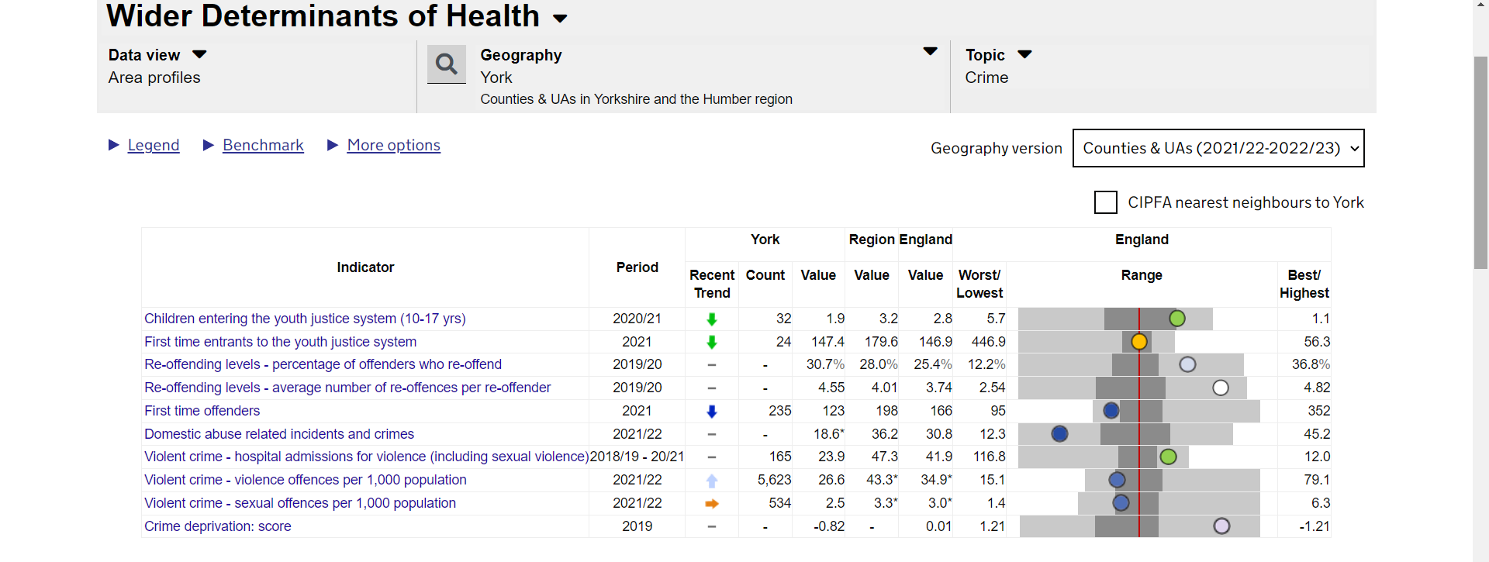
Wider Determinants of Health
Notes:
Toggle by area type to select York. Mention geography version and CIPFA (England comparator by default)

Slide 28
Wider Determinants of Health
Notes:
Toggle by area type to select York. Mention geography version and CIPFA (England comparator by default). Highlight crime deprivation score

Slide 29
Wider Determinants of Health
Notes:
Then select CIPFA (The Chartered Institute of Public Finance and Accountancy) Nearest Neighbours Model

Slide 30
Wider Determinants of Health
Notes:
Then select CIPFA (The Chartered Institute of Public Finance and Accountancy) Nearest Neighbours Model

Slide 31
Local Health
Notes:
Enables us to hone in on specific wards to identify any outliers

Slide 32
Local Health
Notes:
Building a bigger picture (no crime) but other factors can influence or confound this.

Slide 33
Wider Impacts of COVID-19 on Health (WICH) Monitoring Tool
Notes:
Building a bigger picture (no crime) but other factors can influence or confound this.

Slide 34
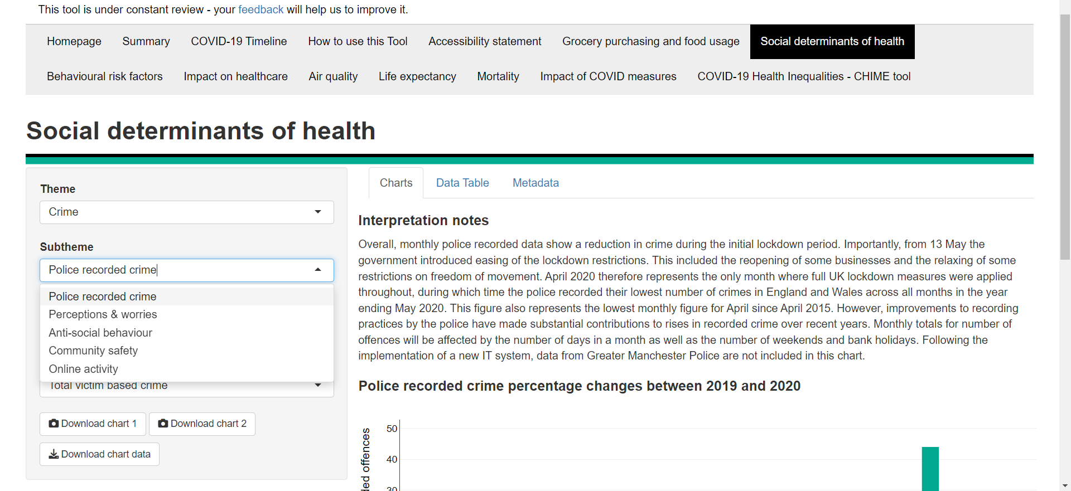
Wider Impacts of COVID-19 on Health (WICH) Monitoring Tool
Notes:
Building a bigger picture (no crime) but other factors can influence or confound this.

Slide 35
Wider Impacts of COVID-19 on Health (WICH) Monitoring Tool
Notes:
Green = drug offences; purple = public order offences; pink = sexual offences; blue = total crime (inc. fraud and computer misuse); lilac = total victim based crime; dark green = violence against the person offences

Slide 36
If you would like more information on the different Fingertips functions please e-mail me on heather.baker@york.gov.uk

Slide 37
Thank you for listening.
Do you have any questions?

