Slide 1
A&E Rates by LSOA
Exploration of A&E Attendance Rates for City of York Residents

Slide 2
Overview
Analysis of A&E attendance rates by LSOA (small area) in CYC
Rates are age and sex standardised
Reviewing by geographical area allows us to look at:
Characteristics of the population (area classification and deprivation)
Properties of the area such as distance to the Hospital, a GP Site or Pharmacy
Just to note that there is an element of variation in the rates that can be impacted right at the start by questioning what counts as an attendance (type 1, type 3, streamed, high intensity users etc)
The following analysis highlights the 10 LSOAs with the highest rates.
However, there are other LSOAs with high rates that are potentially not so different.

Slide 3
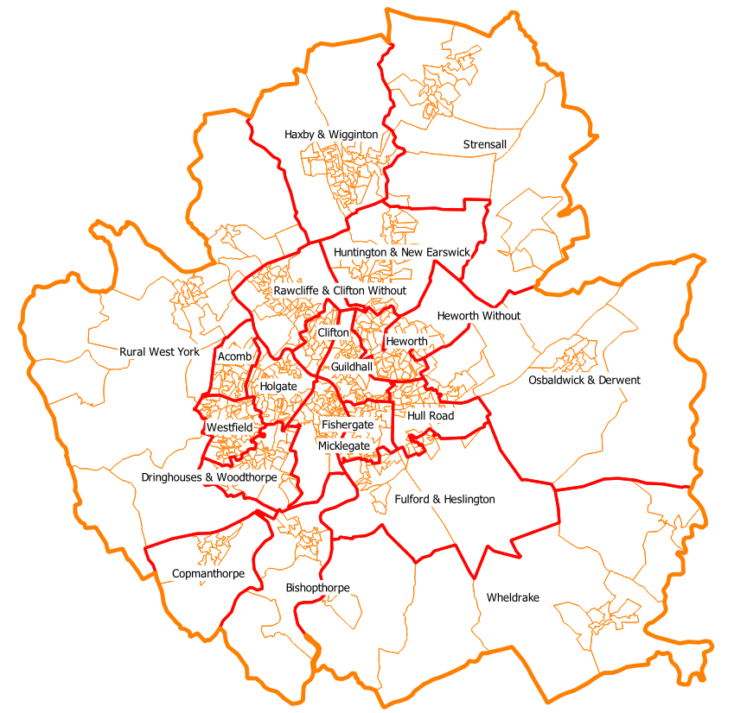
What is an LSOA?
Output Areas and Wards within City of York | Output Areas (OA) were created in 2001 for census data. Based on: Adjacent unit postcodes Characteristics of the actual census data Design considerations include: Similar population sizes Consist of entirely urban or entirely rural postcodes Be as socially homogenous as possible based on tenure of household and dwelling type Average population is about 300 people (2011) Boundaries align to local authority districts (LAD) 637 output areas in City of York. Too small for our analysis (confidentiality)
Notes:
https://www.ons.gov.uk/methodology/geography/ukgeographies/censusgeography#output-area-oa
Unit postcodes are the full postcode: https://www.ons.gov.uk/methodology/geography/ukgeographies/postalgeography
637 output areas in CYC

Slide 4
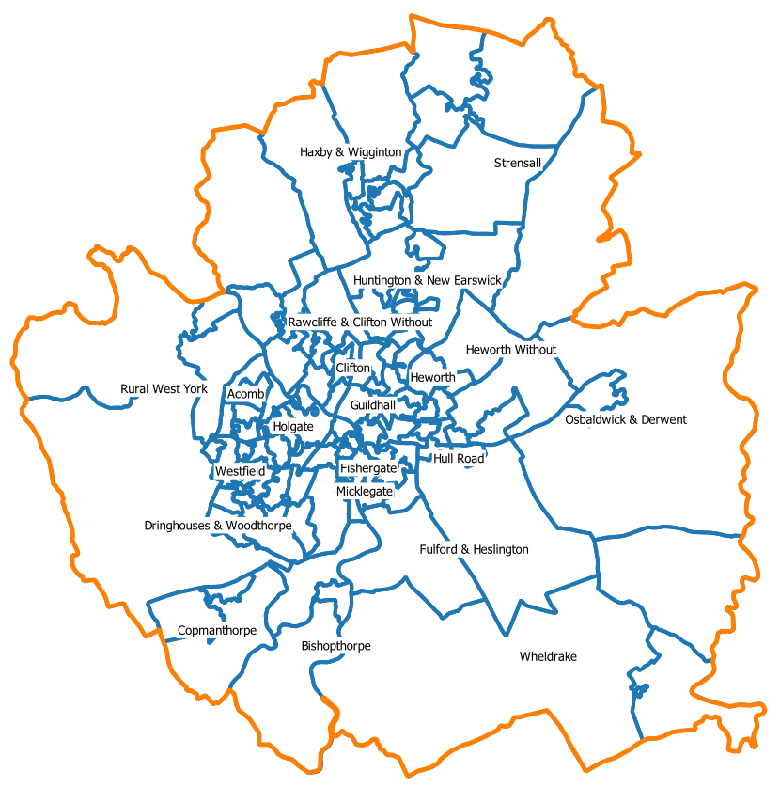
So, what is an LSOA?
Lower Super Output Areas within City of York | Super Output Areas (SOAs) initially introduced for use on Neighbourhood Statistics. Built up from groups of output areas (OAs) and continue to align with local authority boundaries. More statistics are published for Lower (LSOA) and Middle (MSOA) super output areas including deprivation and the area classifications. The 637 output areas in the City of York are grouped into 120 LSOAs.
Notes:
https://www.ons.gov.uk/methodology/geography/ukgeographies/censusgeography#super-output-area-soa
Neighbourhood statistics now published across various other platforms: https://digitalblog.ons.gov.uk/2017/04/19/goodbye-to-old-friends-and-hello-to-the-new/

Slide 5
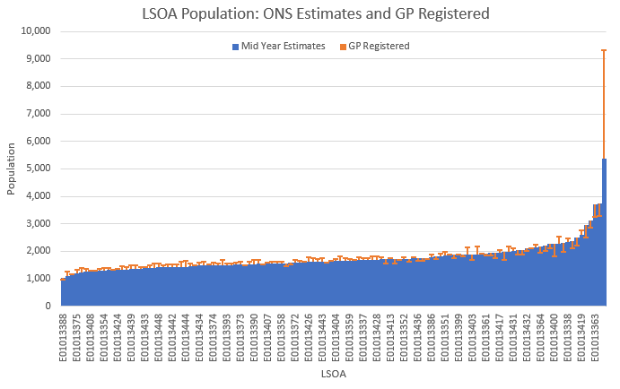
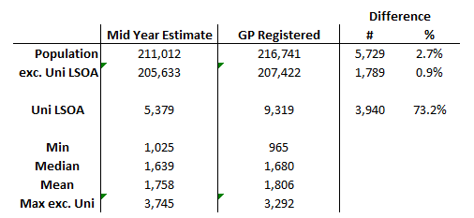
LSOA Populations
We have two sources of population figures at LSOA level: GP Registered (Age/Sex ^{monthly} or LSOA ^{quarterly}) ONS Mid Year Population Estimates (Age/Sex and LSOA) There is some discrepancy between the two sets of figures which is further distorted by the University LSOA: For the purposes of age/ sex standardising the rates, we can only use the ONS mid year estimates.
Note the big difference here between the two sources of population data
Notes:
GP registered figures at LSOA level are published quarterly in Jan, Apr, Jul and Oct
Using July as the comparison month for the mid year estimates
I refer to York University as the ‘University LSOA’ and it stands out because of the student residences (Student population ~20k)
However, there is also York St John University (Student population ~7k) with a variety of accommodation within a mile of campus (https://www.yorksj.ac.uk/study/accommodation/)
Not looking to start an argument over which is correct, just to highlight that at Practice Level, you might see a slightly different picture.

Slide 6
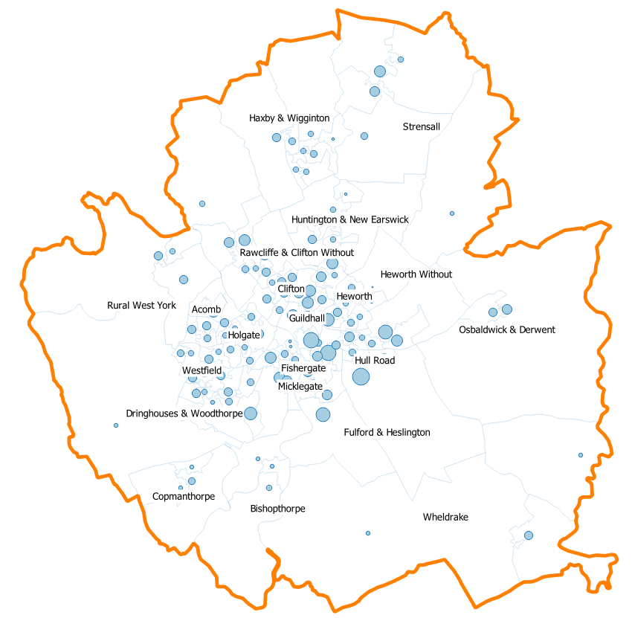
Things we can do with an LSOA
Circle Position shows the population centroid Circle Size represents the population size | We can: See if an LSOA contains, for example, a GP Practice, Care Home, or Pharmacy. Using the population centroid, calculate a simple straight line distance to e.g. York Trust, or the nearest GP Practice site Using Secondary Care Data (SUS) look at counts and rates of activity and standardise these using the population figures Align these with other statistics published at this level such as Area Classifications, Indices of Deprivation, Electricity consumption...
Notes:
The lsoa boundaries can lead to ‘visual’ distortion where our eyes are drawn to the larger (typically rural) areas.
Using the centroid is a way to eliminate this distortion. Can calculate either a geometric or population centroid – see appendix for further examples.
Population Centroid: https://data.gov.uk/dataset/2c5695f2-39d0-457f-a03c-1f4d3617bb48/population-weighted-centroids-guidance
Lower and Middle Super Output Areas electricity consumption - GOV.UK (www.gov.uk)

Slide 7
A&E Attendances – What Data?
York Trust/ Site Only – includes patients subsequently streamed
Type 1 + Type 3 (minor injuries) since only separated from July-20
Period is the 12 months April-20 to March-21
Minor illness at Vocare (Type 3) not directly included due to data quality issues (inc. GP OoH, missing Apr data) but typically captured as streamed in the York data
Removed the impact of multiple attendances (patients with more than one attendance in the period will be counted once only)
Noted high intensity users (e.g. individuals with 30 and 40+ attendances in some cases)

Slide 8
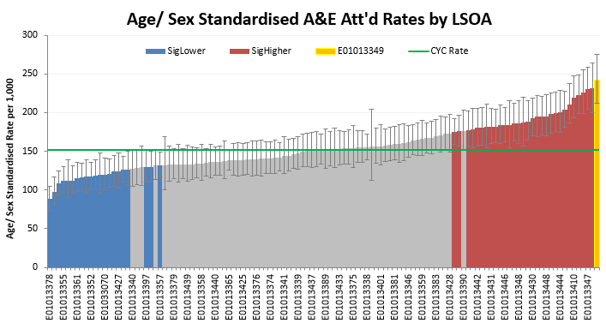
Age Sex Standardised A&E Attendance Rates
 | The average number of attendances across the LSOAs is 250 and ranges from 135 to 475. The rates, adjusted for age and sex, range from 88 to 242 attendances per 1,000 The overall CYC adjusted rate is just over 150 attendances per 1,000 The wide confidence intervals are typically observed when the activity in a given ‘bracket/ strata’ (e.g. male 70-75) is greater than or equal to the ‘estimated’ population.
Notes:
Red bars show LSOAs with rates significantly higher than the CYC average
Blue bars show LSOAs with rates significantly lower than the CYC average
The orange bar is just to highlight a selected lsoa which is used for further investigation
Due to the discrepancy between the mid-year population estimates and activity, in future, it might be necessary to increase the age ranges particularly at the higher age range where population sizes are smaller

Slide 9
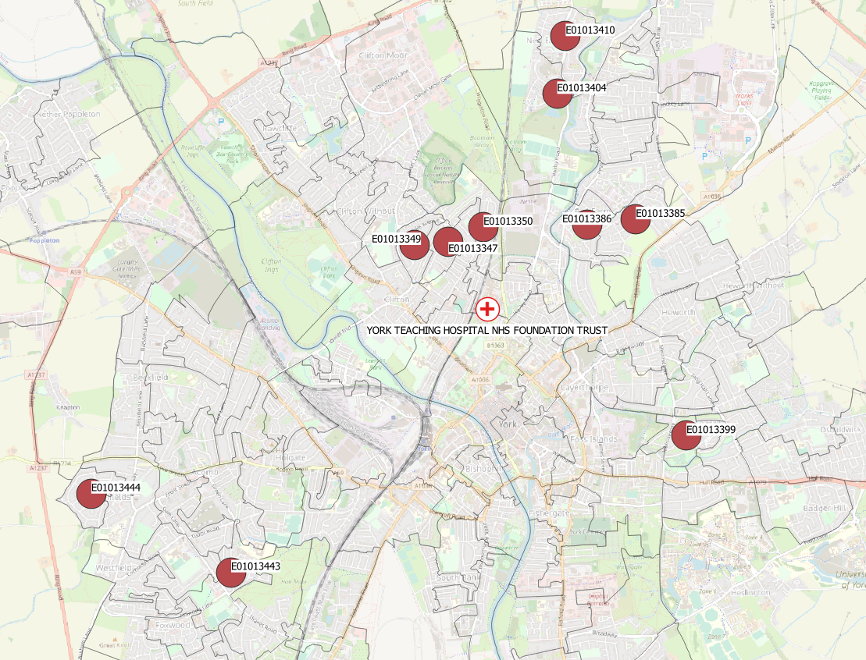
10 LSOAs with the Highest A&E Attendance Rates
Just an observation at this stage regarding the adjacent clusters (ie. LSOAs sharing boundaries):
E01013349, E01013347, E01013350
E01013386, E01013385
E01013404, E01013410
Notes:
With the addition of two LSOAs (E01013431 and E01013348), the above adjacent clusters of LSOAs could form ‘one continuous area’. Connection with Haxby Road and Wigginton Road and access to the trust?
These two LSOAs do have A&E attendance rates (statistically) higher than the CYC average

Slide 10
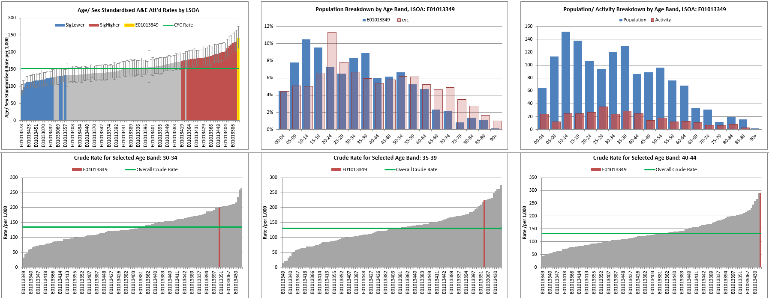
Explore individual LSOAs
Not proposed to do here but it’s possible to review any individual lsoa and look at the age specific rates.
This might, for example, suggest an age-cohort to investigate in more detail.
Notes:
Age specific rates available for each 5 year age range

Slide 11
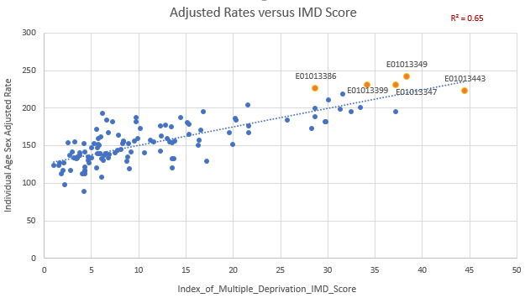
Correlation with Deprivation (IMD)
Strong correlation between deprivation and attendance rate (R = 0.81) The deprivation scores are typically ranked and presented in e.g. deciles: 1 being the most deprived 10 being the least deprived
IMD Score above: | Decile
44 | 1
33 | 2
27 | 3
Low Deprivation
High Deprivation
Notes:
Index of Multiple Deprivation (IMD)
Orange highlighted circles are for the 5 LSOAs with the highest rates
Could add vertical shading here to show the IMD deciles more clearly

Slide 12
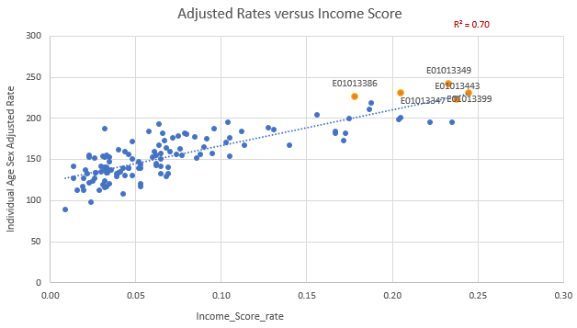
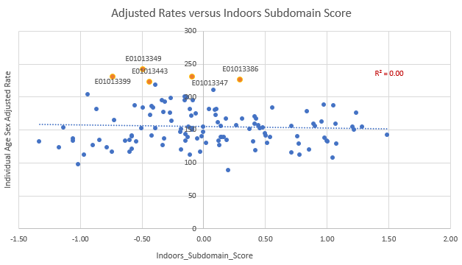
Deprivation Indices
The index of multiple deprivation (IMD) is a combination of numerous indicators across 7 domains (subsequently weighted)
The charts below show that the correlation for some indicators (e.g. Income, R = 0.84) is much stronger than others (e.g. indoors, R = -0.05)
Low Deprivation
High Deprivation
Low Deprivation
High Deprivation
Notes:
Indoors subdomain includes:
Houses without central heating: The proportion of houses that do not have central heating
Housing in poor condition: The proportion of social and private homes that fail to meet the Decent Homes standard.
Weightings of 7 sub domains that make up the IMD:
Income Deprivation (22.5%)
Employment Deprivation (22.5%)
Education, Skills and Training Deprivation (13.5%)
Health Deprivation and Disability (13.5%)
Crime (9.3%)
Barriers to Housing and Services (9.3%)
Living Environment Deprivation (9.3%)

Slide 13
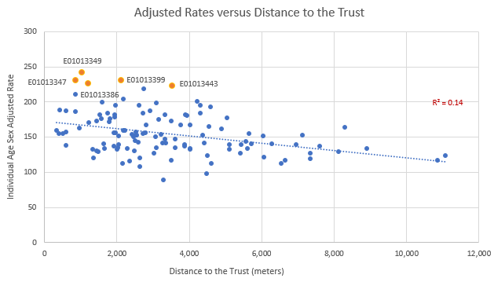
Correlation with Distance
A reasonably strong degree of correlation between distance to the trust and attendance rates (R = -0.37) Note, this is simply the straight line distance between two points ie. as the crow flies It does not take into account, for example, ease of access such as main roads, public transport (travel times) etc See Appendix for comparison with driving and walking times – doesn’t appear to make much difference
Notes:
Consider switching to drive/ walk time analysis (isochrone) rather than straight line distance calculations here

Slide 14
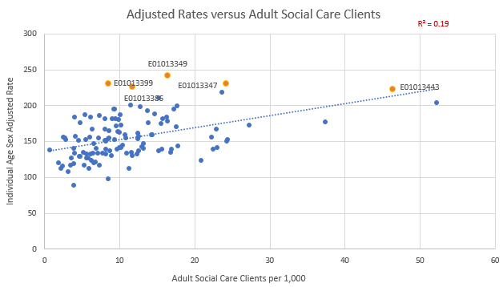
Correlation with Adult Social Care Clients
A reasonably strong degree of correlation between Adult Social Care clients and attendance rates (R = 0.44) A caveat here is that the A&E adjusted rates are for all ages whilst the Adult Social Care Clients are only for ages 18+

Slide 15
10 LSOAs with the Highest A&E Rates ^{Age/ Sex Adjusted}
The LSOAs in the table above are sorted with the highest age/sex adjusted rates at the top
Out of the 10 LSOAs with the highest rates:
5 are in the top 20% most deprived (Deciles 1 and 2)
8 fall under the area classification of ‘Hard-pressed communities’ ^{shaded orange}
Noted that the first two LSOAs listed appear to have a smaller population aged over 64
- The CYC population aged over 64 is around 18%
Notes:
Area classification descriptions: https://www.ons.gov.uk/methodology/geography/geographicalproducts/areaclassifications/2011areaclassifications/penportraitsandradialplots
Hard-pressed communities includes: Constrained renters, Hampered neighbourhoods and challenged white communities
https://mapmaker.cdrc.ac.uk/#/output-area-classification?h=0&lon=-1.0843&lat=53.969&zoom=12
For e.g. Practice, Care Home and Pharmacy within a boundary – one of these sites could be e.g. 50 meters from the centroid and outside the boundary. Another could be 100s of meters frm the centroid but in the boundary so worth looking at on a map before drawing and strong conclusions from this.

Slide 16
Nice Summary Map here…
This isn’t a nice summary map (in progress).
It’s just to show that 7 of the top 10 LSOAs are physically very close to each other. With the addition of 1 LSOA, they would all be connected.
Is it any coincidence that these LSOAs all run along either Haxby or Wigginton Road - possibly indicating ease of access to the trust?
Not to forget about the other LSOAs but is there something worth further investigating here…

Slide 17
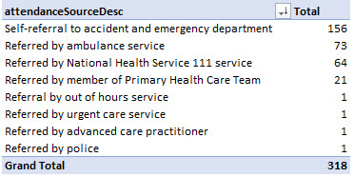
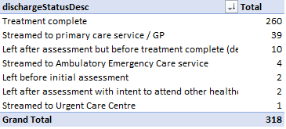
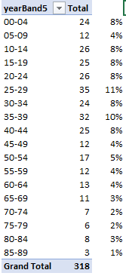
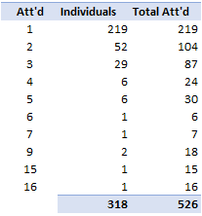
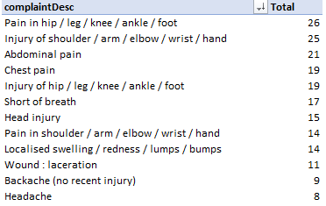
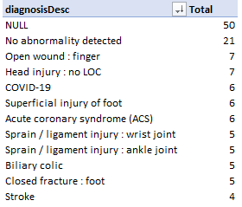
Example LSOA Investigation: E01013349
Majority of patients are registered with either Priory (48%) or York Medical Group (45%)
There were 318 individuals from this LSOA attending A&E in the period.
Tables below are to give an indication of the additional detail available further description in the notes
Notes:
This data can be sliced and diced to focus on any subset eg. a particular age group, a particular condition or by time of day
Discharge status – a number of patients captured in York’s ED data will subsequently be streamed. This should be within 15 minutes but the average time for the above streamed patients is 37 mins.
The top diagnosis code of null is for patients that are streamed. Whilst a complaint should always be recorded, a diagnosis will not necessarily be.
yearBand5 simply shows the proportion of activity broken down into the 5 year age bands (these are the bands used for calculating the age adjusted rates)
The chart on the right is to show that the 318 individuals accounted for 526 total attendances in the period.
219 patients had one attendance, 52 patients had two attendances each… One patient had 15 attendances in total and another 16.
There are 12 patients with 5 or more attendances (5+ considered high intensity users). These patients accounted for 92 attendances (3.8% individuals resulted in 17.5% of total attendances)

Slide 18
Further Work
So, what next?
Probably a case of taking individual LSOAs and reviewing in-depth
This could include:
Age Specific Rates investigation
Focus on different cohorts of patients – children? In/ Out of hours etc
Note the clusters of LSOAs just north of the trust – almost adjacent
High Intensity Users not included here. A separate analysis?

Slide 19
Appendices

Slide 20
Caveats
Individuals with more than one attendance across the period are only counted once. The picture might look different if we were to include patients with 2 attendances or up to 5 etc
Patients with multiple attendances often appear with different addresses across the period. For these purposes, they are assigned to their last known address.
Population figures are estimates – so the rates are not exact
The confidence intervals are fairly wide. It wouldn’t be surprising to see the order of the LSOAs shift just by looking at a different period
Notes:
Use the last known address simply because in previous work, identifying high intensity users – we would use the last known GP practice to share these details

Slide 21
A&E Rates by LSOAs +/- Care Home
Not done any further calculations but the median and mean rates for LSOAs with (+) and without (-) a care home are almost identical.
Inter quartile range for LSOAs with care homes is much narrower (?)
34 out of 120 LSOAs have a care home
Notes:
No obvious difference in the rates of LSOAs with a care home and those without

Slide 22
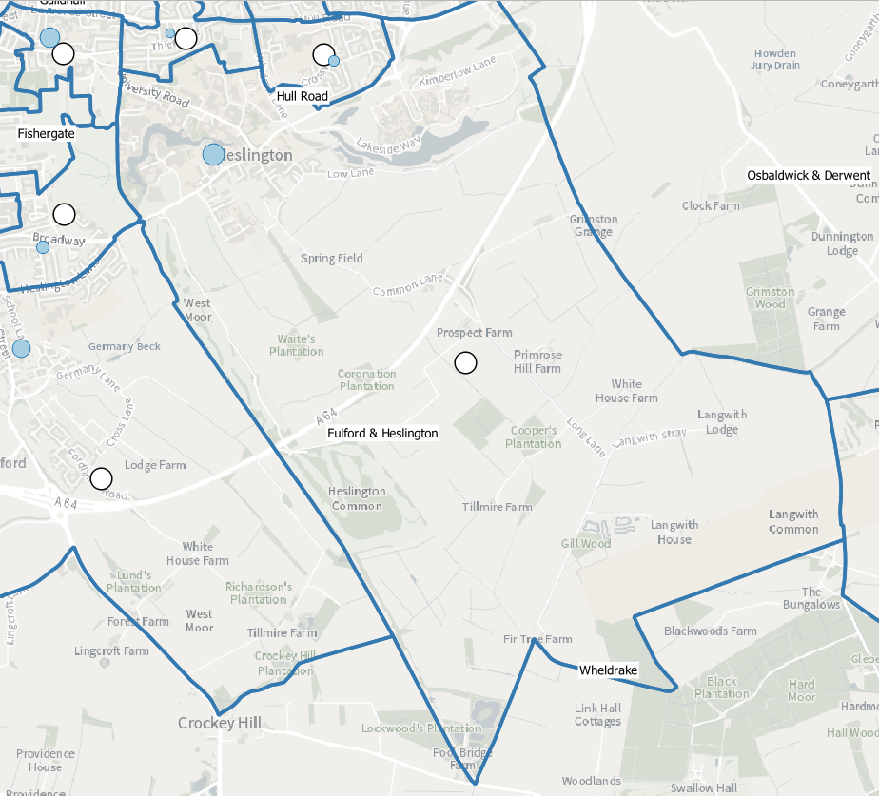
LSOA - Centroids
The map to the left shows the difference between the population and geometric centroid for the University LSOA.
In this example, the geometric centroid is the middle of farm land and quite rural. The population centroid aligns much more closely with the university residences.
Distance calculations are based on the population centroid.
For smaller areas, the distances between the two points will be smaller (can see some other LSOAs to the side).
Occasionally, a geometric centroid will fall outside its own boundary.
Population centroid
Geometric centroid
Notes:
Population Centroid: https://data.gov.uk/dataset/2c5695f2-39d0-457f-a03c-1f4d3617bb48/population-weighted-centroids-guidance

Slide 23
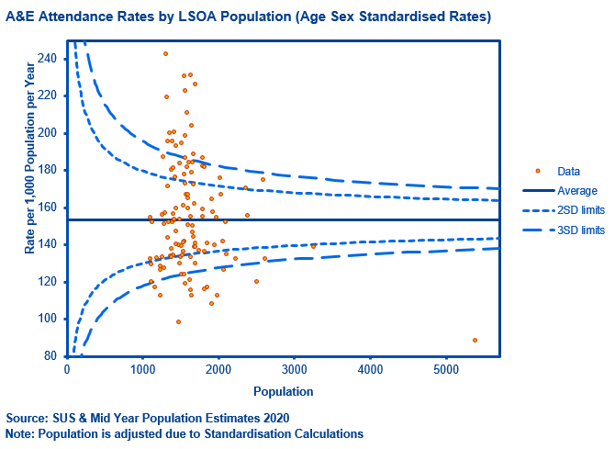
Rates don’t align with funnel
Overdispersion…
Need to understand and narrow down. Would it look any different for individual 5 year age bands.

Slide 24
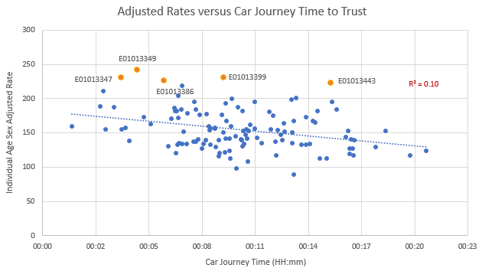
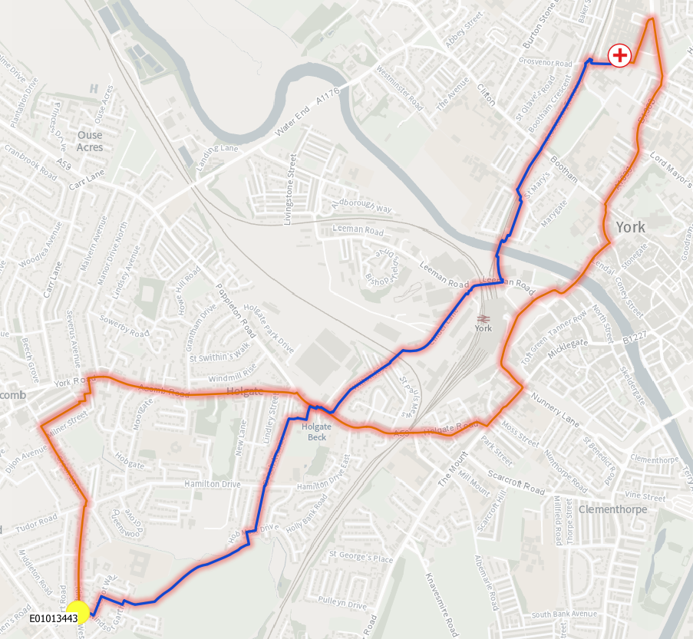
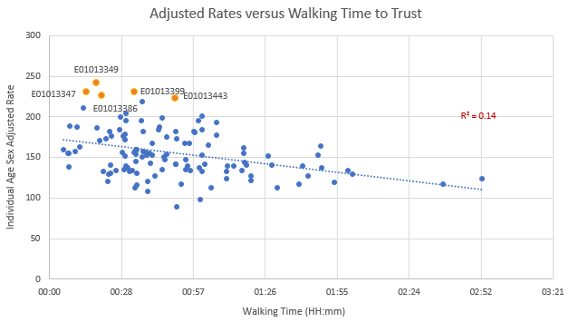
Correlation with Travel Times
A previous slide showed the correlation between the straight line distance from the lsoa centroid to the Trust (R=-0.37)
Using travel times instead:
the correlation with walking is identical to the straight line distance (R=-0.37)
For car journeys, the correlation is slightly less (R=-0.31) – all but one lsoa has a car journey time within 20 minutes
Notes:
Travel Times based on Open Street Map: https://openrouteservice.org/
For this example, lsoa E01013443, the blue line shows the fasted calculated walking route (50 minutes (4.2km)), the red line the driving route (15 minutes (5.7km))

Slide 25
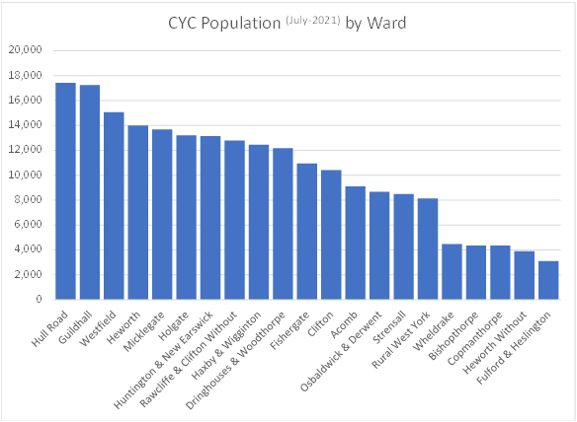
Ward Population
Although wards have recognisable names and geographies:
their population sizes are much more varied
It is less appropriate to assign a ‘characteristic’ to a geography on this much larger scale
Ward population in CYC ranges from 3,000 to 17,500.
Average is 10,300 (median is 11,000)

